Slide 1
Project IoT Monitoring Tambak Udang Vanname
IoT and IDE Introduction
Nama : Gusti Arsyad
Email : suriv27121994@gmail.com

Slide 2
Problems and Objective
Shrimp ponds have the potential to be worked on, especially since Indonesia is a maritime country rich in natural resources such as agriculture, coal, gold, fisheries and others. Especially in the fisheries of vannamei shrimp cultivators where there is a trend of market demand both nationally and globally, Indonesia must be able to supply vannamei shrimp so quickly and the shrimp needs must be available, so vannamei shrimp farming is very appropriate for this. However, there are obstacles, namely when the harvest does not match expectations because there is death of the shrimp before the time of harvest, due to many factors, especially the lack of water pH, temperature, and humidity. So the presence of technology such as IoT which can monitor water pH conditions and so on from ponds is expected to be able to overcome this problem. Thus increasing the yield and quality of vanname shrimp optimally.

Slide 3
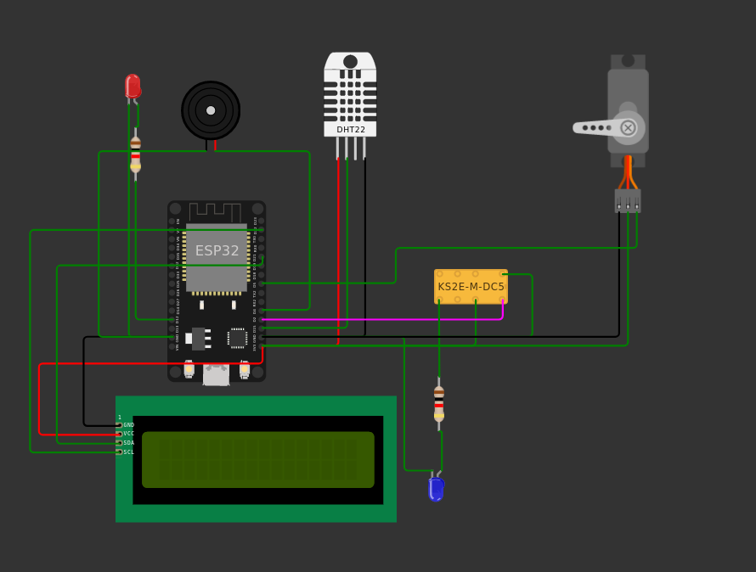
Project explanation code and schematic
Hardware architecture concept

Slide 4
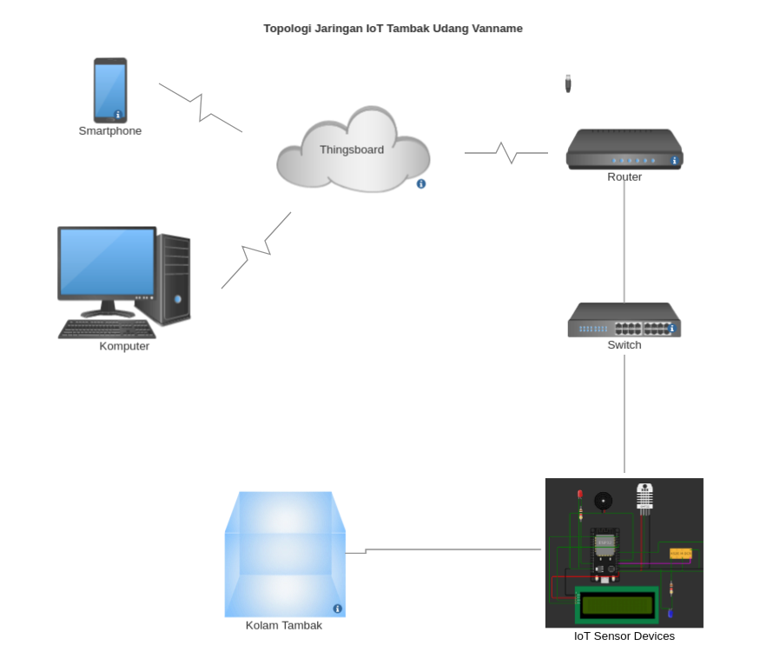
Design of Topology

Slide 5
Import library
#if defined(ESP8266)
#include <ESP8266WiFi.h>
#elif defined(ESP32)
#include <WiFi.h>
#endif
#include <Wire.h>
#include <LiquidCrystal_I2C.h>
#include "DHTesp.h"
#include "ThingsBoard.h"
#include <ESP32Servo.h>
Inisialiasi ke thingsboard client
// Initialize ThingsBoard client
WiFiClient espClient;
// Initialize ThingsBoard instance
ThingsBoard tb(espClient);
// the Wifi radio's status
int status = WL_IDLE_STATUS;
Define server dan token
#define TOKEN "pSc39SFe6z8bwzPXDVfy"
#define THINGSBOARD_SERVER "thingsboard.cloud"

Slide 6
Create variable
const int heatPin = 12;
const int bzrPin = 4;
const int servoPin = 5;
const int relayPin = 2;
//SENSOR DHT22
const int DHT_PIN = 15;
DHTesp dhtSensor;
Servo servo;
int pos = 0;
LiquidCrystal_I2C LCD = LiquidCrystal_I2C(0x27, 16, 2);

Slide 7
Method for LCD
//LCD 16X2
void spinner() {
static int8_t counter = 0;
const char* glyphs = "\xa1\xa5\xdb";
LCD.setCursor(15, 1);
LCD.print(glyphs[counter++]);
if (counter == strlen(glyphs)) {
counter = 0;
}
}
void stdbyScreen() {
LCD.setCursor(8, 0);
LCD.println("SMART");
LCD.setCursor(0, 1);
LCD.println("POUND-V1");
}

Slide 8
Method setup
void setup() {
// put your setup code here, to run once:
Serial.begin(115200);
dhtSensor.setup(DHT_PIN, DHTesp::DHT22);
pinMode(heatPin, OUTPUT);
pinMode(bzrPin, OUTPUT);
servo.attach(servoPin, 500, 2400);
pinMode(relayPin, OUTPUT);
LCD.init();
LCD.backlight();
LCD.setCursor(0, 0);
LCD.print("Connecting to ");
LCD.setCursor(0, 1);
LCD.print("WiFi ");
InitWiFi();
}

Slide 9
Method for connecting and sending data to thingsboard
void loop() {
// put your main code here, to run repeatedly:
delay(1000); // this speeds up the simulation
if (WiFi.status() != WL_CONNECTED) {
reconnect();
}
if (!tb.connected()) {
// Connect to the ThingsBoard
Serial.print("Connecting to: ");
Serial.print(THINGSBOARD_SERVER);
Serial.print(" with token ");
Serial.println(TOKEN);
if (!tb.connect(THINGSBOARD_SERVER, TOKEN)) {
Serial.println("Failed to connect");
return;
}
}
Serial.println("Sending data...");
// Uploads new telemetry to ThingsBoard using MQTT.
// See https://thingsboard.io/docs/reference/mqtt-api/#telemetry-upload-api
// for more details
TempAndHumidity data = dhtSensor.getTempAndHumidity();
tb.sendTelemetryInt("temperature", data.temperature);
tb.sendTelemetryFloat("humidity", data.humidity);
Serial.print("Temperature : ");
Serial.print(data.temperature);
Serial.print(" Humidity : ");
Serial.println(data.humidity);
Serial.println("Data on the north side of the pond . . . .");
checkTemperature();
lcdMonitor();
tb.loop();
}

Slide 10
Method for checking temperature
void checkTemperature(){
TempAndHumidity data = dhtSensor.getTempAndHumidity();
if(data.temperature < 26){
digitalWrite(heatPin, HIGH);
digitalWrite(bzrPin, HIGH);
LCD.setCursor(8, 0);
LCD.println("WARNING");
LCD.setCursor(0, 1);
LCD.println("Cold Temperature");
// LCD.Clear();
}else if(data.temperature > 34){
for (pos = 0; pos <= 180; pos += 1) {
servo.write(pos);
delay(15);
}
for (pos = 180; pos >= 0; pos -= 1) {
servo.write(pos);
delay(15);
}
LCD.println("WARNING");
LCD.setCursor(0, 1);
LCD.println("Hot Temperature");
//LCD.Clear();
}else{
digitalWrite(relayPin, HIGH);
lcdMonitor();
}
}

Slide 11
Method for LCD
void lcdMonitor(){
TempAndHumidity data = dhtSensor.getTempAndHumidity();
LCD.setCursor(8, 0);
LCD.println("SMRTPND-V1");
LCD.setCursor(0, 1);
LCD.println("Temperature : ");
LCD.print(data.temperature);
}

Slide 12
Method connect and wifi // Wifi
void InitWiFi()
{
Serial.println("Connecting to AP ...");
// attempt to connect to WiFi network
WiFi.begin("Wokwi-GUEST", "");
while (WiFi.status() != WL_CONNECTED) {
delay(1000);
Serial.print(".");
}
Serial.println("Connected to AP");
spinner();
}
//Check reconnect
void reconnect() {
// Loop until we're reconnected
status = WiFi.status();
if ( status != WL_CONNECTED) {
WiFi.begin("Wokwi-GUEST", "");
while (WiFi.status() != WL_CONNECTED) {
delay(1000);
Serial.print(".");
}
Serial.println("Connected to AP");
spinner();
}
}

Slide 13
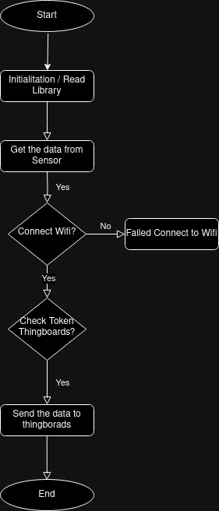
Flowchart

Slide 14
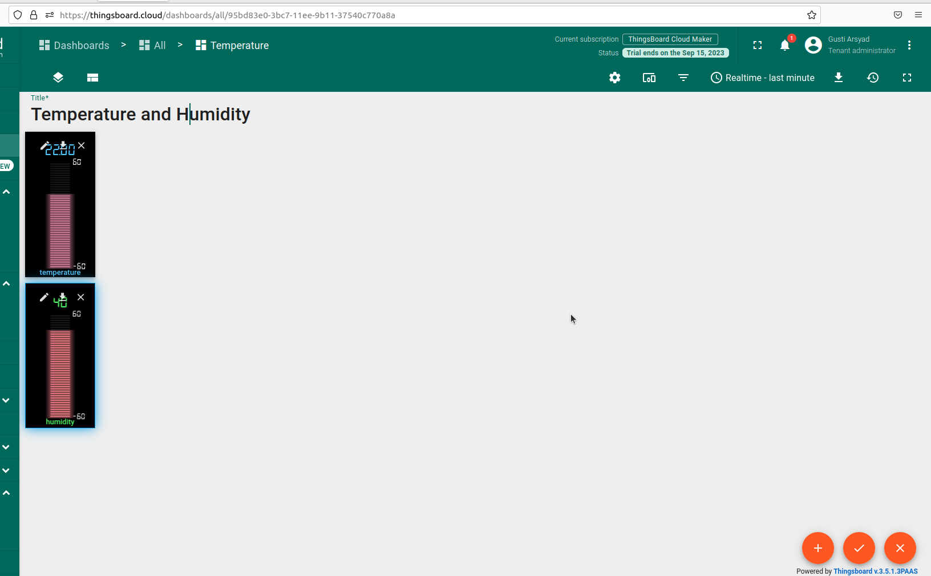

Slide 15
Conclusion
The trend of IoT usage data has greatly increased due to the support of 5G technology and other hardware so that it is possible for the widespread use of IoT, including monitoring vannamei shrimp ponds which is very much needed by pond entrepreneurs in Indonesia. So IoT for monitoring vanname shrimp ponds is expected to help shrimp pond entrepreneurs to increase yields both in terms of quantity and quality of vanname shrimp.

Slide 16
THANK YOU

